Slide 1



RustBelt: Securing the Foundations of the Rust
Programming Language
● Adam McDaniel ● Alexander Krneta ● Matthew Jones ● Kapildev Neupane ●
Notes:
Kapildev

Slide 2
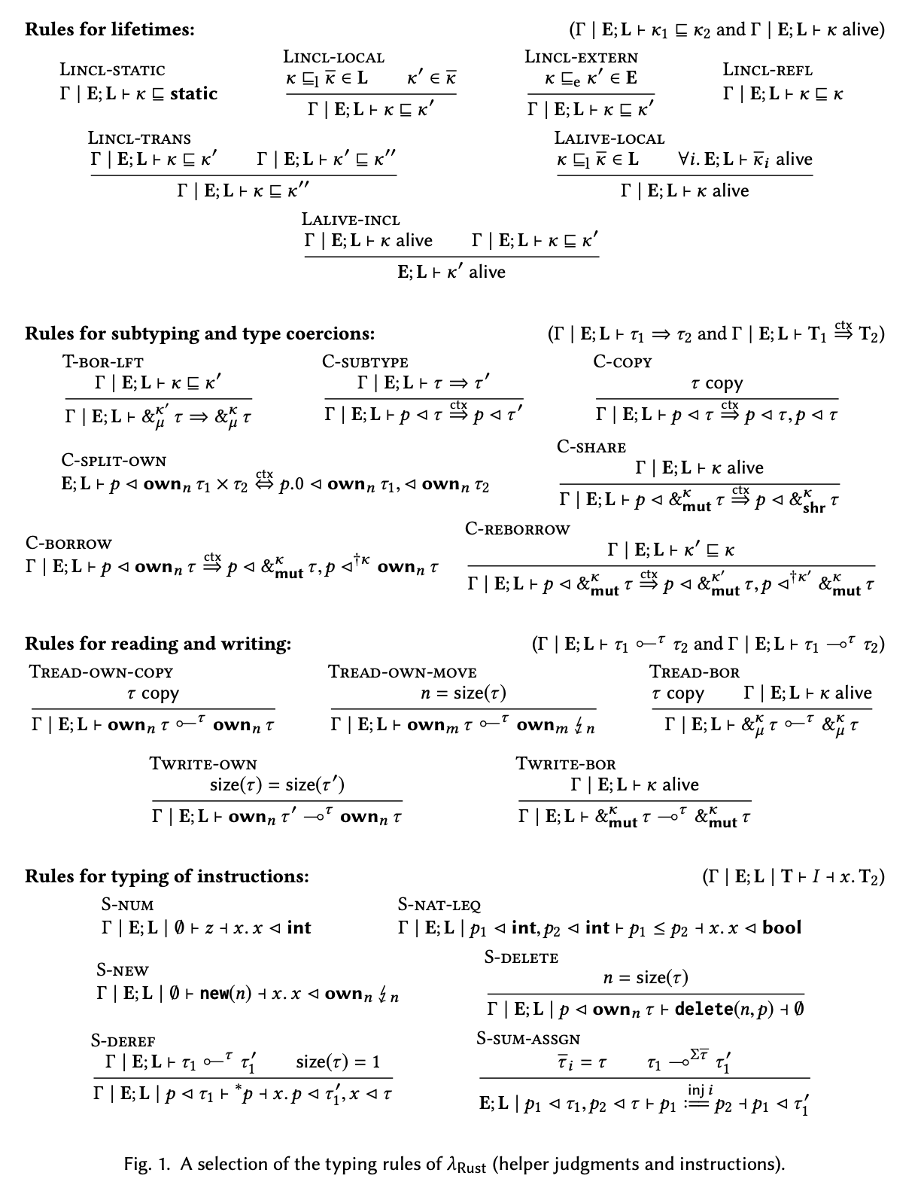
Brief Overview: Rust’s Type System Formally Verified
The selected paper for this presentation covers two main topics:
The history of adding safety to C-like languages. Rust was born out of research exploring a safe dialect of C: Cyclone.
The paper presents a formal proof for Rust’s type system: Rust’s memory safety guarantees are 100% sound, checked using the Coq theorem proving assistant.
Ultimately, this paper is about demonstrating the real developer productivity benefits of Rust’s memory model.
Figure 1: Rust’s type-system rules formalized in Sequent Calculus
Notes:
Kapildev

Slide 3
The Dilemma With Established Programming Languages
Notes:
Adam

Slide 4
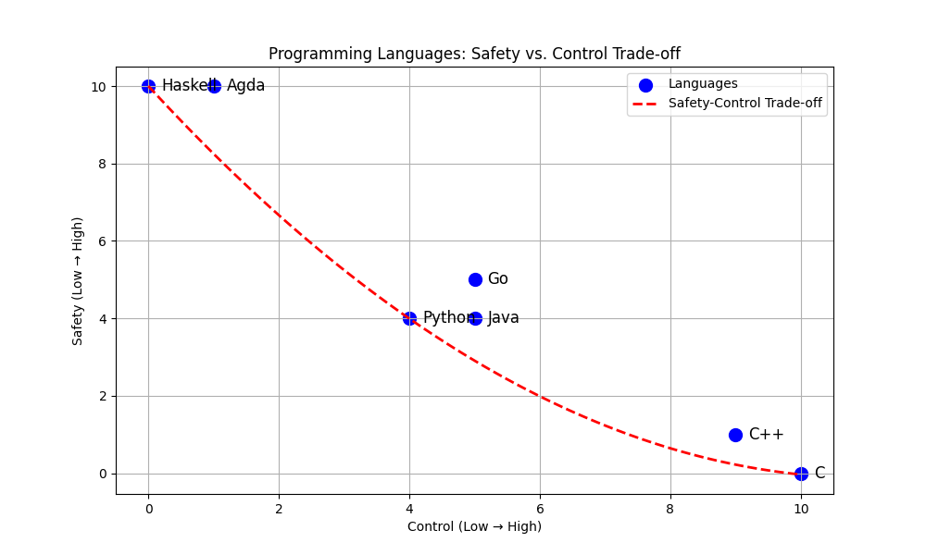
Safety vs. Control
All programming languages strike some opinionated balance between two features: safety and control.
Safe languages restrict the developer’s expressiveness in favor of eliminating certain classes of bugs.
Languages with high control allow the developer to work less inhibited, but it also allows you to “shoot yourself in the foot.”
Figure 2: Charting the relationship between developer control + productivity against programming language safety.
Notes:
Adam

Slide 5
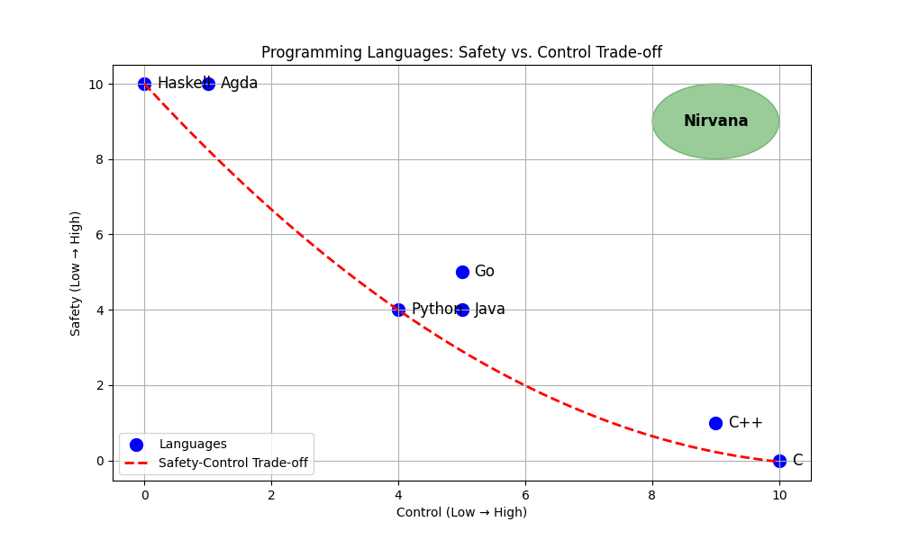
An Ideal Programming Language
An ideal programming language is one that lies at the intersection of maximum safety and maximum control.
The user cannot write code that shoots themselves in the foot due to safety checks.
The constraints are permissive. They don’t interfere with direct control over the machine.
This maximizes productivity: less time is spent debugging, but the developer can still write practical code uninhibited.
Figure 3: An ideal language would maximize safety and control.
Notes:
Adam

Slide 6
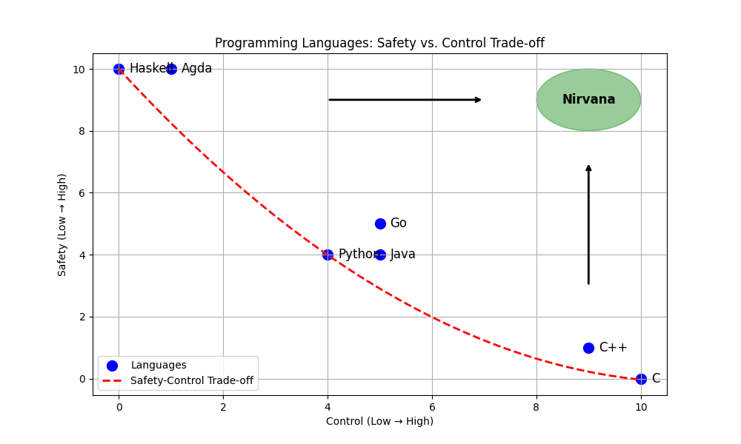
Recent Trends In Language Design
In recent years, programming language research has focused on making practical languages safer, and safe languages more practical.
Examples include:
Typescript on top of JS.
Additions to C++: std::optional and std::variant to avoid null dereferencing and unsafe unions.
Wider adoption of functional programming techniques.
Figure 4: Recent trends show a tendency towards a better balance in safety and control in comparison to older techniques.
Notes:
Adam

Slide 7
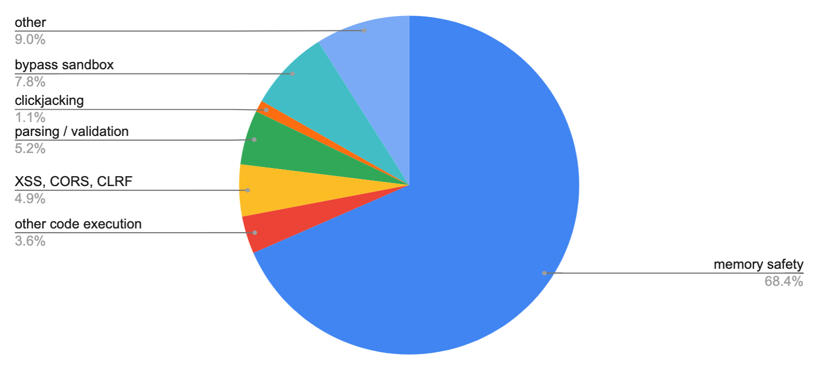
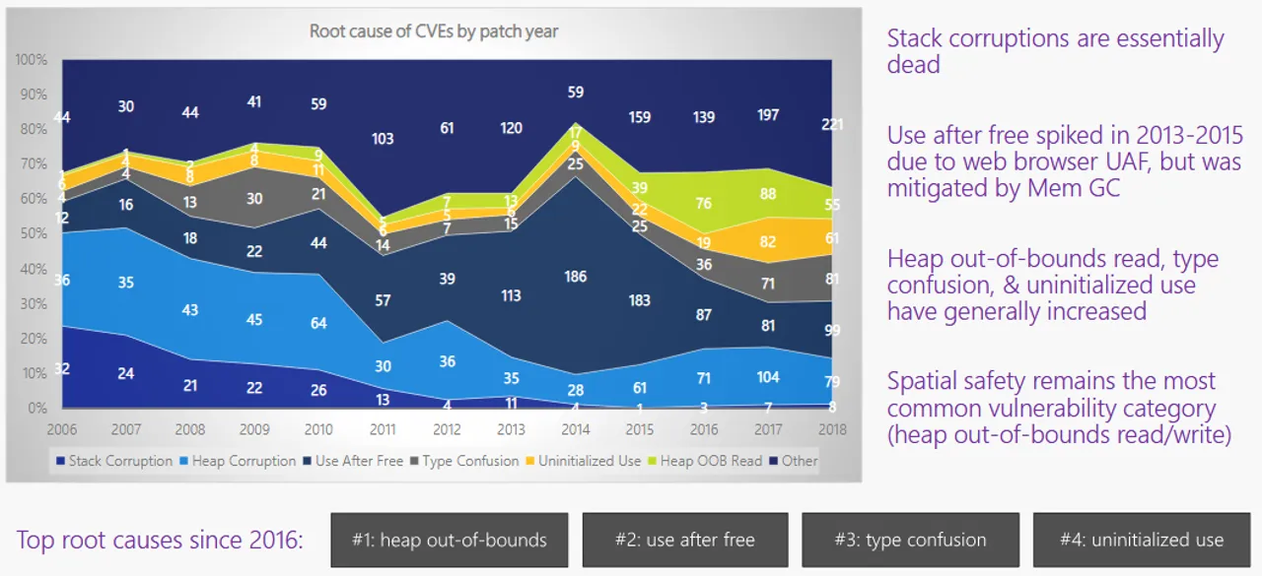
Biggest Safety Concern: Memory Management
Memory safety is the biggest cause of most bugs and security flaws in modern software.
Google and Microsoft report that memory errors compose 70% of their software defects.
Traditionally, programming languages prevent invalid memory usage with runtime checks:
Garbage collection
Reference counting
Removing pointer semantics from the language entirely
These strategies come at a high sacrifice to the developer:
Large, cumbersome runtimes
Slower programs
Users can’t access memory directly
Unsuitable for embedded, operating systems, etc.
Figure 5: ~70% of all security bugs in Chrome are memory errors, as reported by Google.
Figure 6: Microsoft finds a similar percentage of memory error contributions to bugs, ~70%
Notes:
Kapildev

Slide 8
New Techniques For Memory Safety
Notes:
Kapildev

Slide 9

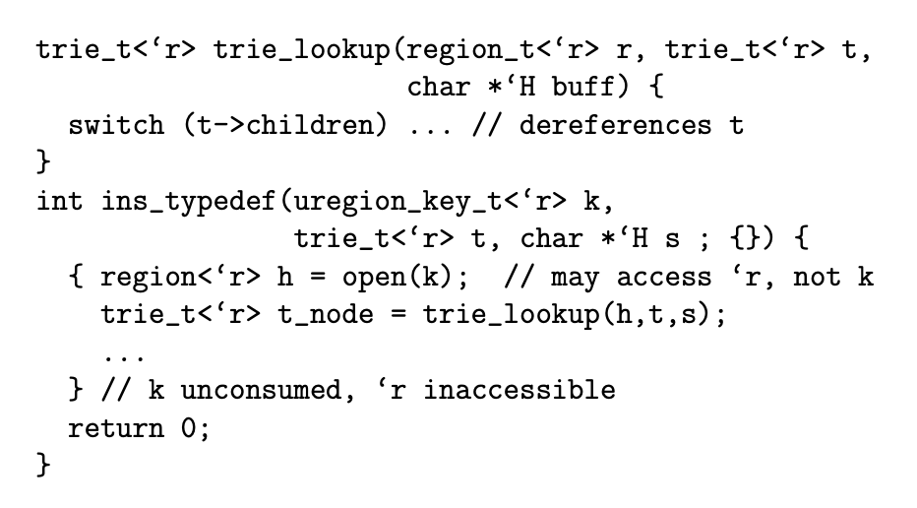
Rust’s Predecessor: Cyclone
Cyclone is one of the first attempts at a memory safe dialect of a C-like language.
Cyclone’s compiler statically deduces how long pointers live, and confirms validity of all pointer accesses.
This comes at a productivity cost:
Pointer lifetimes are always explicitly written by the programmer.
Juggles multiple specialized pointer types.
Exceptions (setjmp, longjmp), pointer arithmetic, type casts, and more are disallowed.
Cyclone is safer than C, but much less practical due to the major sacrifices.
Figure 7: Example code snippet for Cyclone, the precursor to Rust
Notes:
Kapildev

Slide 10
Enter: The Rust Programming Language
Notes:
Matthew

Slide 11
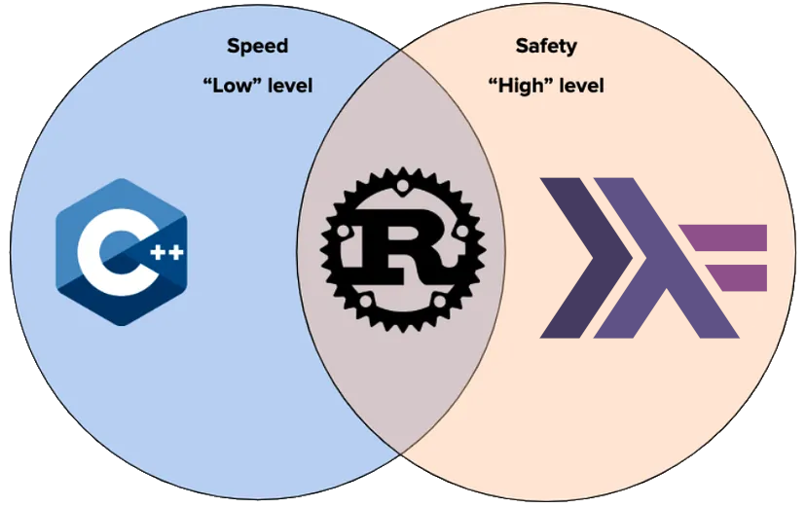
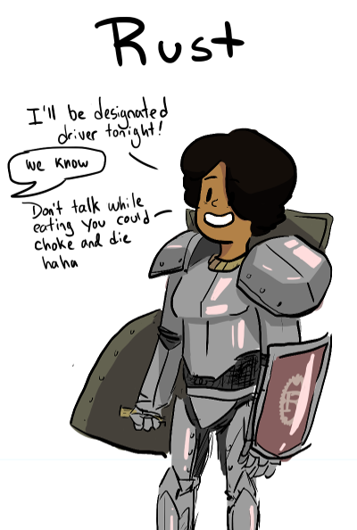
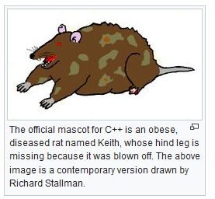
The Rust Programming Language
Rust is a programming language, built on the research from Cyclone, with a better balance of safety and developer burden.
Rust avoids many of the pitfalls of Cyclone:
The same pointer/reference types as C++, no extra types needed.
Pointer lifetimes are inferred — little to no developer burden.
Pointer arithmetic, type casts, etc. are allowed, unlike Cyclone.
Figure 8: Rust’s in comparison to C++ and Haskell’s design choices
Notes:
Matthew
Rust uses linear types - RAII - Resource Acquisition is Initialization

Slide 12
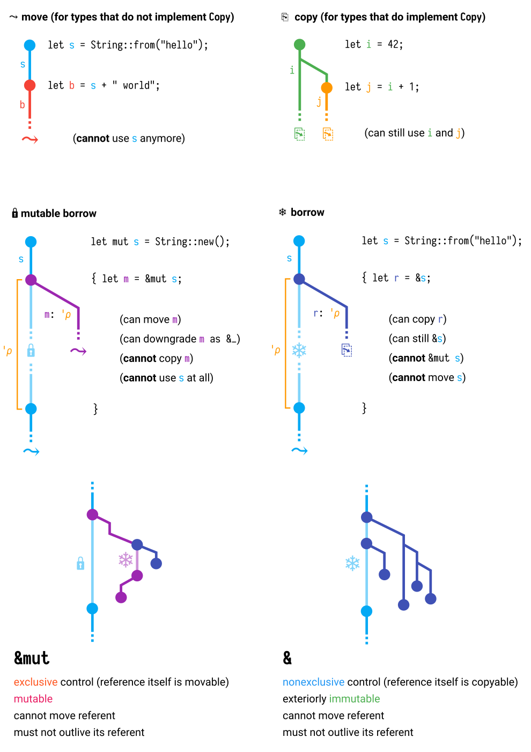
Rust’s Memory Model: Ownership & Borrowing
Rust’s introduces a new strategy for managing memory: the ownership and borrowing model.
The borrow checker enforces just the following four rules to enable Rust’s safety guarantees:
Each value has a single owner (one variable owns the data)
When the value goes out of scope, it is dropped (memory is freed)
You may have exactly one mutable reference or infinite immutable references to a value at a time
Live references must always be valid
Figure 9: Rust’s ownership and borrowing rules
Notes:
Matthew

Slide 13
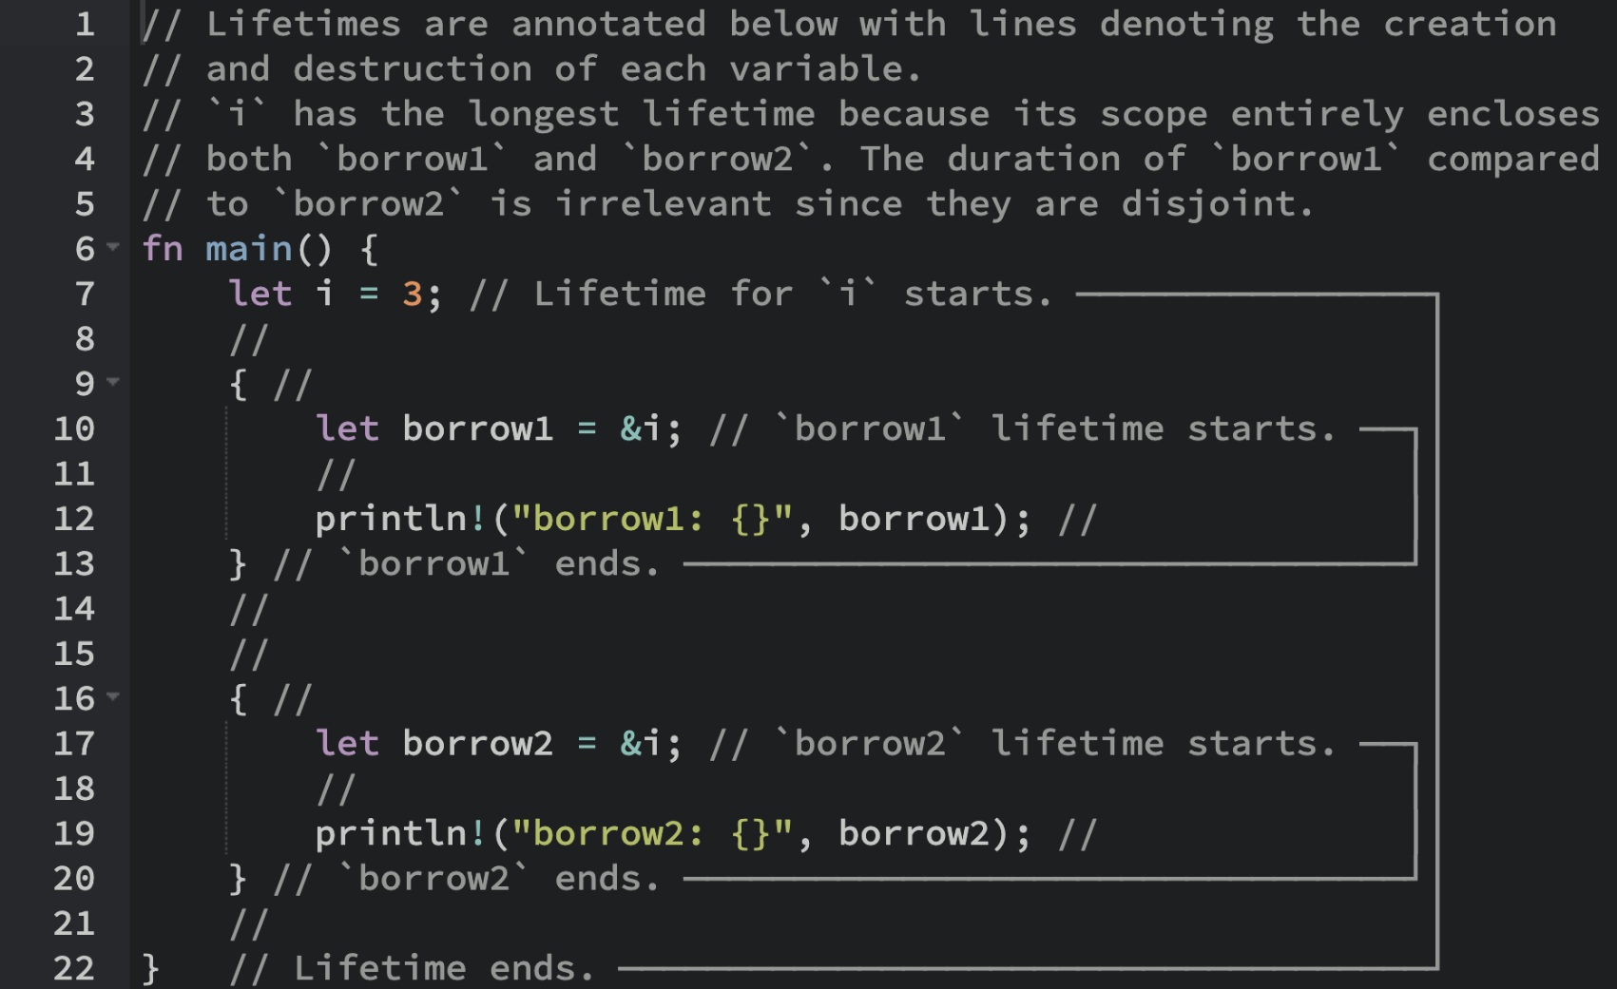

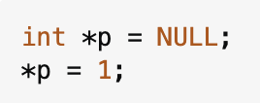
The Benefits Of Ownership & Borrowing
Rust’s innovative memory model allows developers to access all the usefulness of languages like C++, while eliminating memory errors.
The ownership and borrowing model statically guarantees:
Automatic memory management without GC!
No use-after-free
No double-frees
No null-pointer dereferences
No thread data races
Ownership and borrowing also enables optimizations that are impossible for C++
Enforcing a single variable “owner” per value permits powerful strict-aliasing optimizations
Figure 10: Rust’s borrowing semantics through an example.
Figure 11: Rust performing an exorcism against access violations.
Notes:
Matthew

Slide 14
If Rust is so safe, it must give up expressiveness… right?

Slide 15
A Tour De Force Of Rust’s Expressiveness

Slide 16
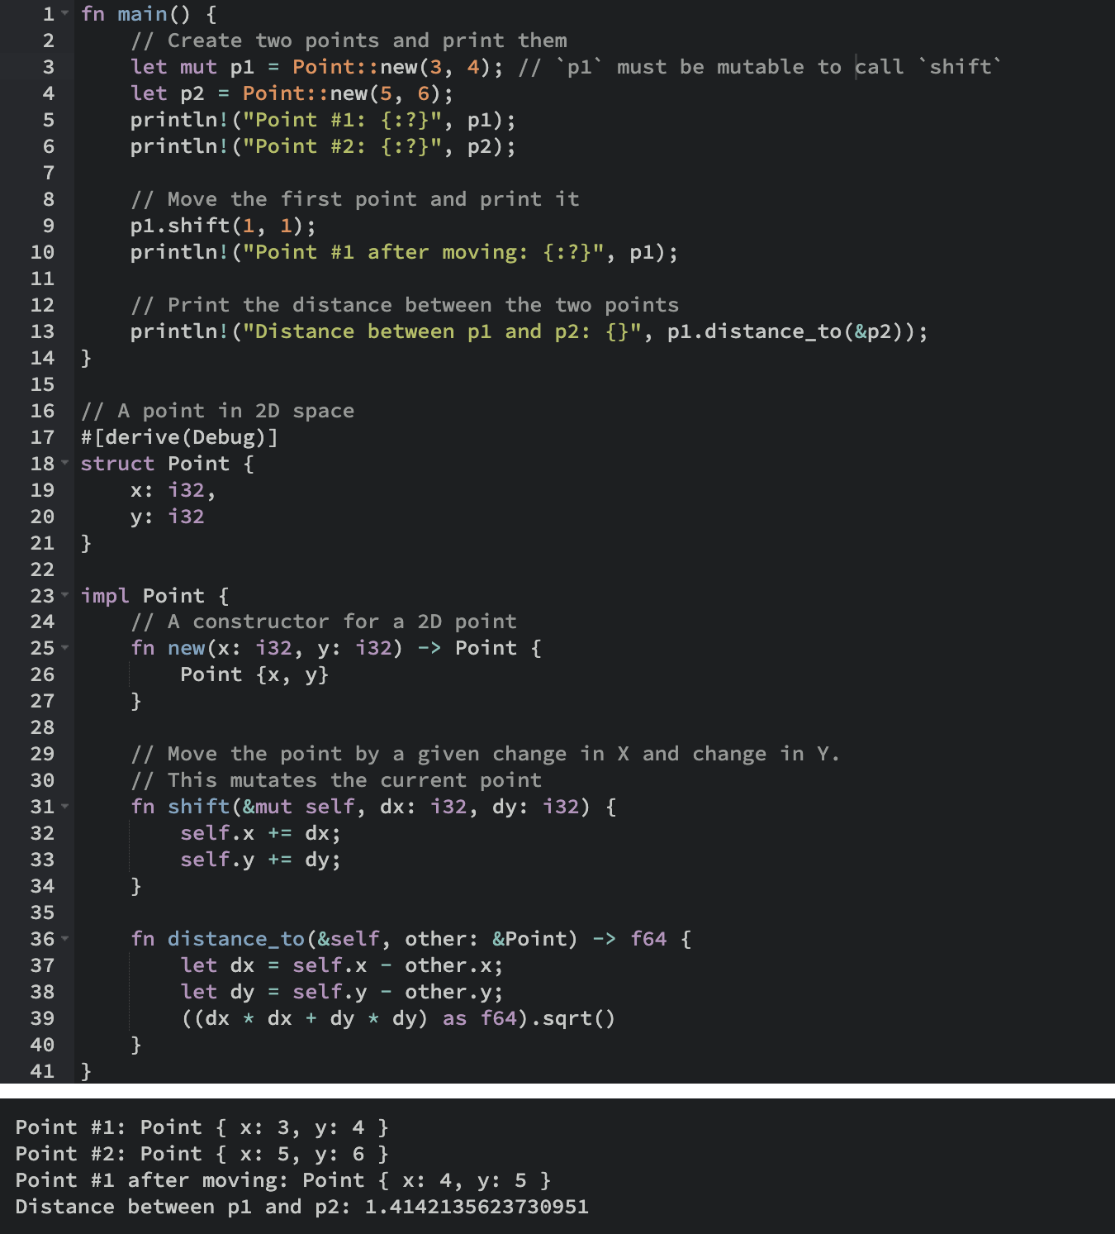
Rust Is Expressive Without Compromise
To the right is an example program that shows some of Rust’s expressive power: it’s similar to typical C++ code.
No safety annotations to be found! Programmers can focus on what matters.
Zero-cost abstractions: Rust programs perform on-par with manually managed C++ code.
No runtime cost for safety!
Figure 12: An example Rust program implementing a 2D point data-type.

Slide 17
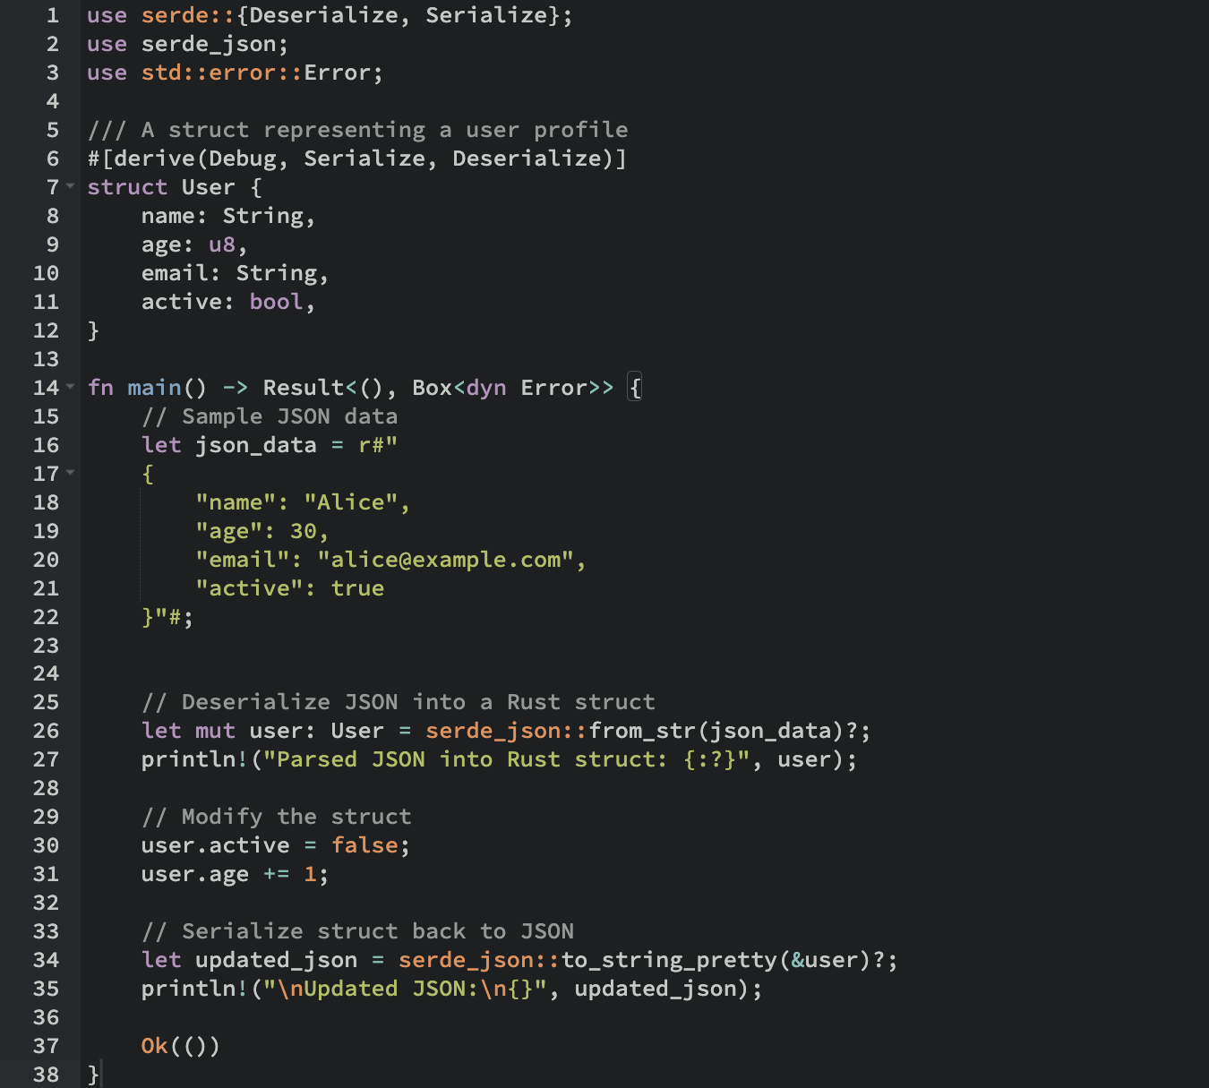
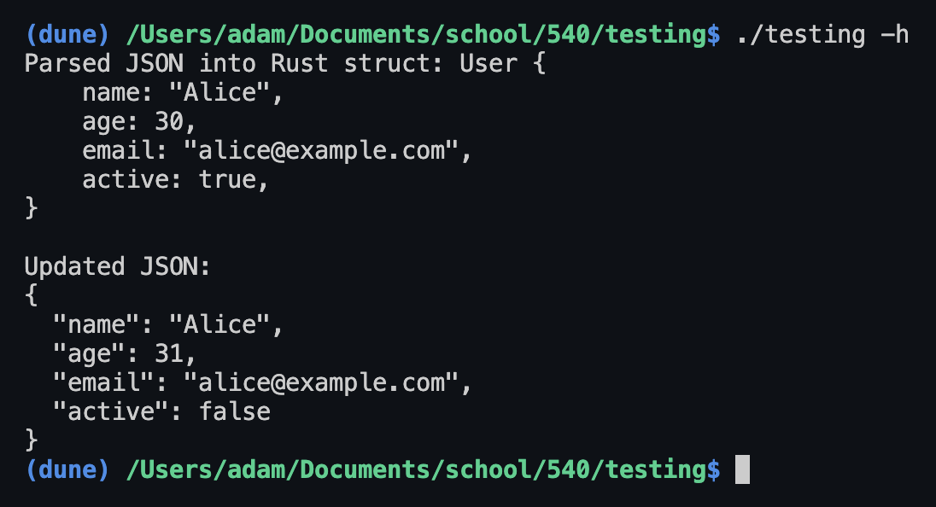
Rust Is Expressive Without Compromise
Despite its great performance and safety guarantees, it often feels like there’s no trade-offs.
This example converts a custom data-structure to/from JSON, while gracefully handling possible errors.
An equivalent program in C++ would be more complex, and can’t statically generalize for arbitrary custom data-types in the same way.
Figure 13: Convert custom data-types to/from JSON.
Figure 14: Program output for bidirectional JSON conversion.

Slide 18
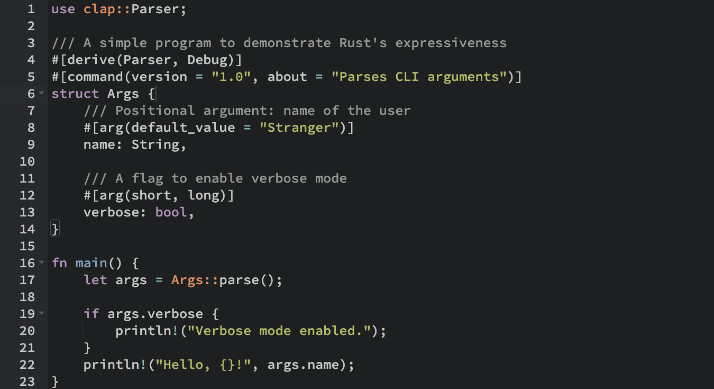
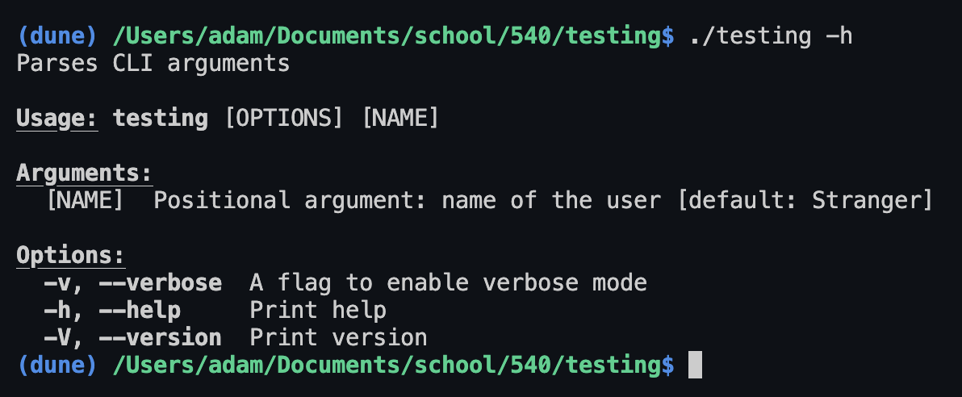
Rust Is Expressive Without Compromise
Here, we implement a simple command-line argument parser.
Rust auto-generates the parse method for our arguments, which are parsed into the fields of our Args struct.
Any user can create and publish their own convenient libraries, just like this one!
Figure 15: Parse command line arguments.
Figure 16: The “help” output of the program.

Slide 19
Overview Of Rust’s Soundness Proof And Sequent Calculus

Slide 20
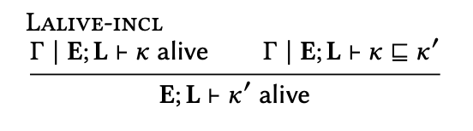
Explaining The Formal Proof Notation By Example #1
The notation used in this paper to formally communicate the type system rules is called “Sequent Calculus”
The top of a sequent calculus rule denotes a condition. The top expression implies the bottom expression.
Condition #1: Γ | E; L ⊢ 𝜅 alive
Given a type environment Γ with an expression context E and a lifetime context L, such that the lifetime 𝜅 is judged to be “alive”
Condition #2: Γ | E; L ⊢ 𝜅 ⊆ 𝜅′
The lifetime 𝜅 is included in 𝜅′ — meaning that the lifetime 𝜅 is outlived by 𝜅′
Conclusion: E; L ⊢ 𝜅′ alive
If 𝜅 is alive in the environment, and 𝜅′ outlives 𝜅, then 𝜅′ is alive.
If a lifetime 𝜅 is alive, and 𝜅′ outlives 𝜅, then 𝜅′ must also be alive.
Notes:
Adam

Slide 21
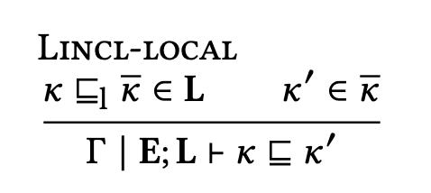
Explaining The Formal Proof Notation By Example #2
Condition #1: 𝜅 ⊆_{l} ̅𝜅 ∈ L
𝜅: Denotes an individual lifetime 𝜅, meaning values tied to this lifetime can still be referenced.
𝜅 ⊆_{l} ̅𝜅: This expresses a local scope constraint: the lifetime 𝜅 is a local lifetime in ̅𝜅. No references tied to 𝜅 can outlive ̅𝜅.
̅𝜅 ∈ L: The set of lifetimes ̅𝜅 are tracked in the checker’s lifetime context denoted by L.
Condition #2: 𝜅′ ∈ ̅𝜅
The lifetime 𝜅′ is accessible in ̅𝜅. However, this doesn’t establish any constraints on 𝜅′, it may outlive lifetimes in ̅𝜅.
Conclusion: Γ | E; L ⊢ 𝜅 ⊆ 𝜅′
It is provable in this environment that 𝜅 lives at most as long as 𝜅′.
References to local variables in a scope cannot outlive their parent scope.
Notes:
Adam

Slide 22
A lot of notation later…
The entire set of rules is multiple pages long.
These rules are then transcribed into the Coq theorem proving language.
If an invalid memory access operation is possible with these rules, then it will be included in the set well-typed programs.
The proof assistant confirms that it is impossible to construct use-after-frees, double-frees, null-pointer-dereferences, etc. in the set of well-typed programs.
Figure 17: One section of the list of type-checking rules enforced in Rust.
Notes:
Adam

Slide 23
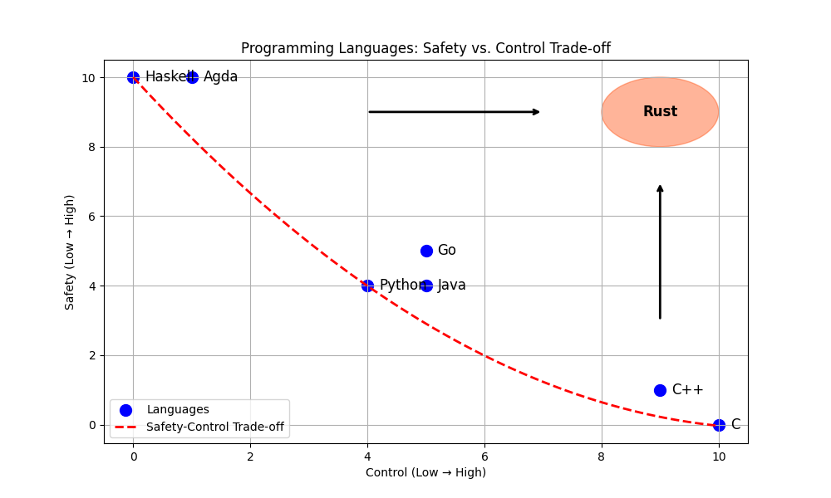
Conclusion
The “ownership and borrowing” memory model pioneered in Rust’s type system is a very important advancement towards increasing developer productivity:
This model prevents hard-to-detect bugs at compile time, while maintaining the expressiveness of widely used systems languages: little to no sacrifice.
Rust’s memory model is now formally proven.
Future languages now have a proven template for statically preventing memory errors and data races.
Smart pointer types based on Rust’s type-checking rules could be integrated into the standard libraries of other established systems languages.
Rust represents a substantial step towards languages with an ideal balance of safety and practicality.
Figure 18: Rust has innovated significant progress towards a safe, practical systems language.
Notes:
Adam

Slide 24
Questions?

